Slide 1
Bot!Battle!
Game Display Team
Josiah Hertzler
Taha Siddique
Jack McFann
Tom Hoffman
Sawyer Brown

Slide 2
Bot!Battle! System
Game Evaluation
Playback Mode
Testing Mode
Contests
Web Development
Game Challenges

Slide 3
Problem
SLIDE TO ELABORATE ON OUR PART OF THE PROBLEM

Slide 4
Solution
Game Display Module
Playback Mode
Testing Arena

Slide 5
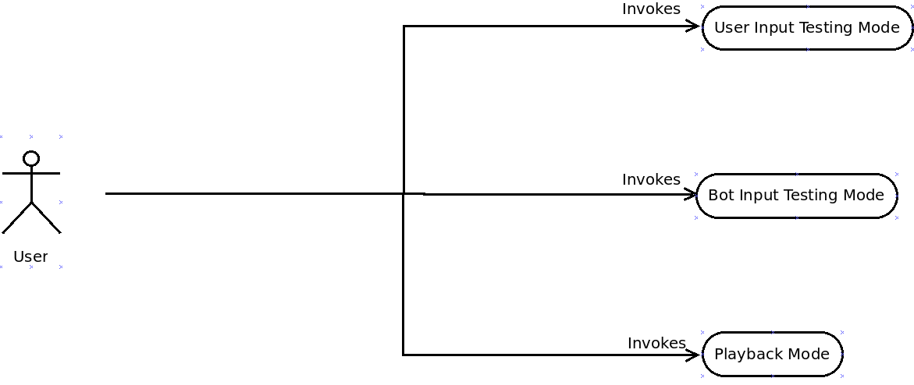
Use Case Diagram

Slide 6
Game Display Module
Draw sprites
Display animations

Slide 7
Playback Mode
View completed matches
Speed Slider
Turn by turn
Easy to use

Slide 8
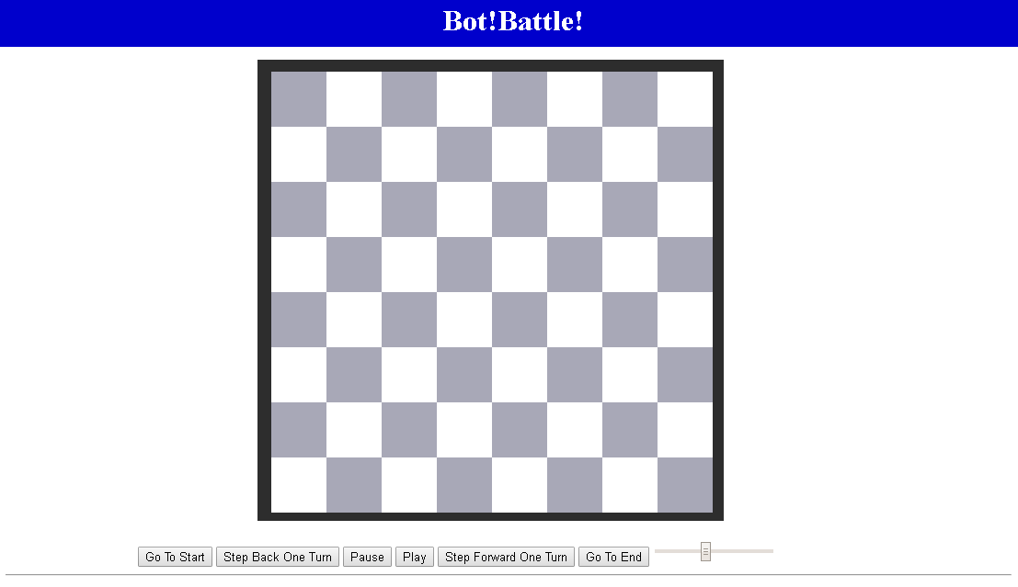



Slide 13


Slide 14



Slide 15
Testing Arena
Debugging Mode
Update bot each turn
Upload File
Edit Code
Test against other bots
Public Bot
Default Bot

Slide 16
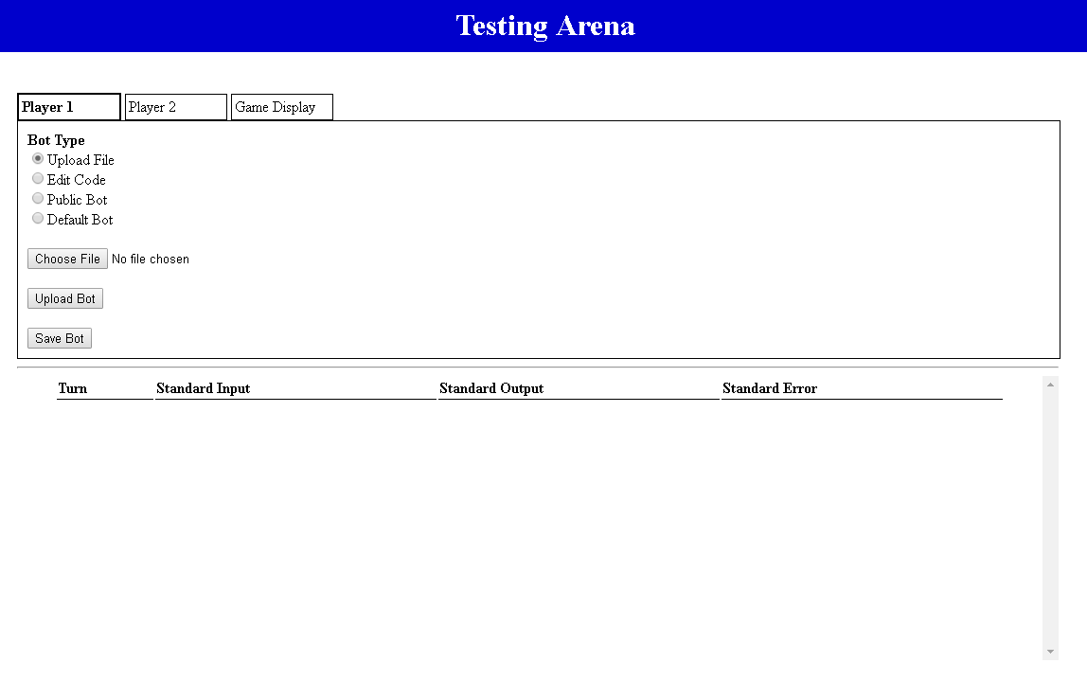

Slide 17
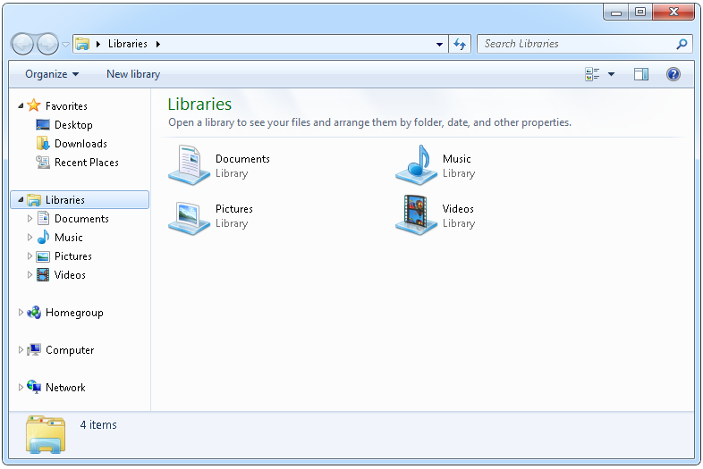

Slide 18
//Template Code for bot
public static void main(String args) {
System.out.print(“Hello!”);
}

Slide 21
Capture The Flag
Math Based Game Challenge
Balance Attack and Defense
Many layers of strategy
Aggressive vs Conservative
Attack Focus vs Defense

